Slide 1
Scientific literacy & inquiry (SL&I)
SEMESTER 3
September 9, 2026 Session 4
Jennifer A. Campbell, PhD, MPH
Course Director

Slide 2
SLI Session | Date | Time Start | Time End | Topic | Instructor | Graded Assessments | USMLE Alignment
Session 1 | 07/29/26 | 1:00 PM | 2:30 PM | Special Topics in Research Part I - Behavioral Economics | Dr. Ekwunife | Active Learning | Epidemiology/population health: Survival Analysis Interpretation
Session 2 | 08/05/26 | 1:00 PM | 2:30 PM | Special Topics in Research Part II - Behavioral Economics | Dr. Ekwunife | Active Learning + UB Learns 3 Attempt Quiz | Epidemiology/population health: Survival Analysis Interpretation
Session 3 | 08/26/26 | 1:00 PM | 2:30 PM | Special Topics in Research Part I - Survival Analysis | Dr. Fraser | Active Learning | Epidemiology/population health: Survival Analysis Interpretation
Session 4 | 09/09/26 | 1:00 PM | 2:30 PM | Special Topics in Research Part II - Survival Analysis | Dr. Fraser | Active Learning + UB Learns 3 Attempt Quiz | Health care policy and economics
Session 5 | 10/07/26 | 1:00 PM | 2:30 PM | Biostats | Dr. Sharma | Active Learning | Distributions of Data; Correlations, Regression, Uses and Interpretation
Session 6 | 10/21/26 | 1:00 PM | 2:30 PM | Biostats | Dr. Sharma | Active Learning + UB Learns 3 Attempt Quiz | Distributions of Data; Correlations, Regression, Uses and Interpretation
Session 7 | 11/04/26 | 1:00 PM | 2:30 PM | Final exam |  | Final exam

Slide 3
Learning Outline
Didactics (30 minutes)
Active Learning (55 minutes)
Open Book Quiz Reminder (5 minutes)
  Opens Monday 09/14 and closes 09/18 (focus on upcoming exam first)

Slide 4
Special topics in Research
Survival Analysis Part 2
Dr. Raphael Fraser

Slide 5
Learning Objectives
Understanding Kaplan–Meier curves
Interpret hazard ratios (HRs) in the context of clinical outcomes, including confidence intervals.
Describe the Cox proportional hazards model, including its assumptions, interpretation of coefficients/HRs, and clinical applications for time-to-event data.
Apply key concepts of Survival Analysis

Slide 6
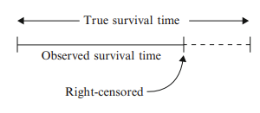
Review Last Session (Survival Analysis Part I)
Censoring
Survivor Function, S(t) = P(T > t)
Hazard Function, h(t) instantaneous risk

Slide 7
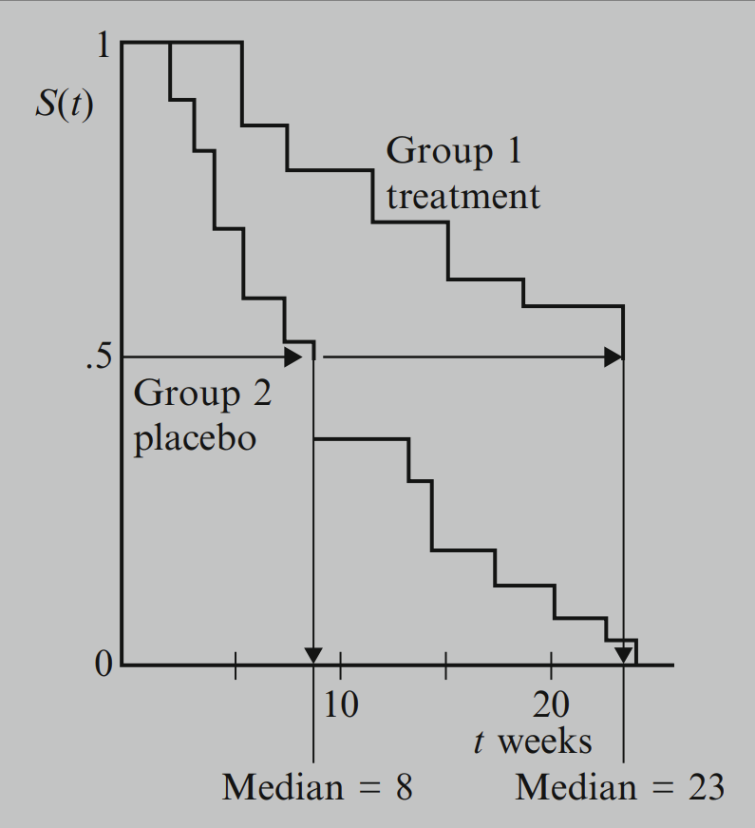
Median Survival
Median survival is the time corresponding to 50% survival
Placebo: at 8 weeks, 50% survival
Tx: at 23 weeks, 50% survival
Doesn’t always exist. See

Slide 8
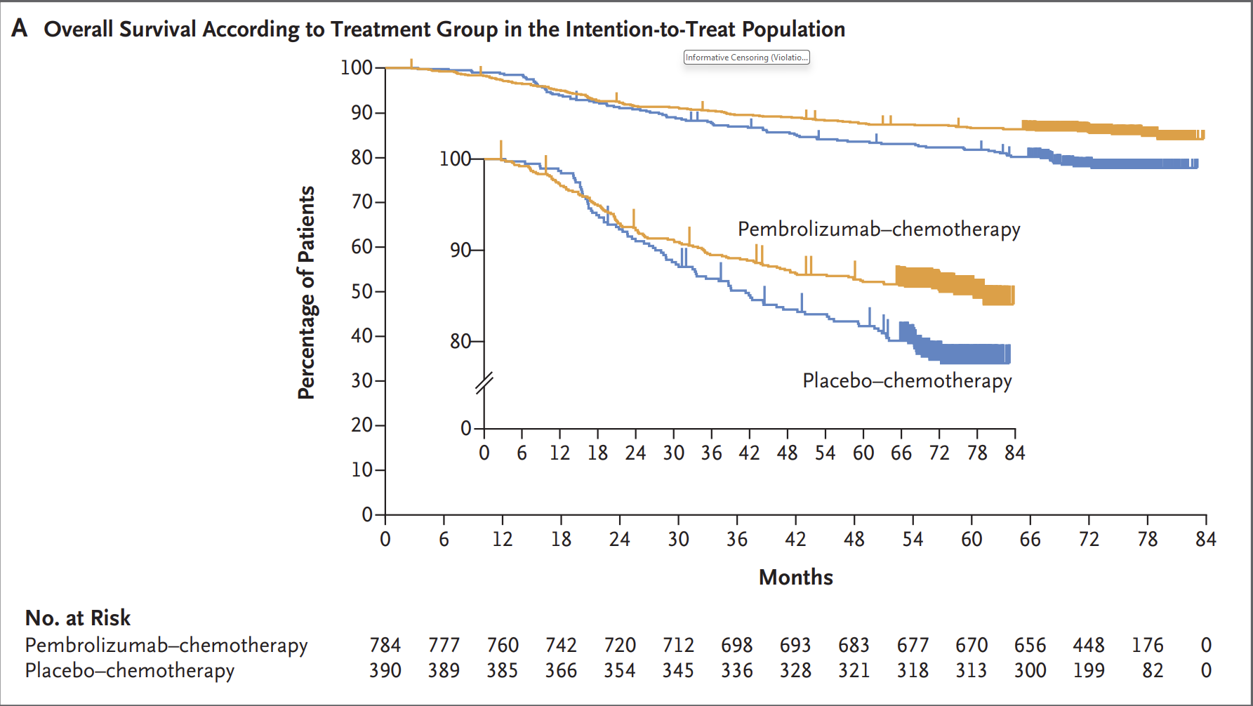
Kaplan Meier Curves

Slide 9
How do we compare KM Curves
Log-rank test: test whether there’s a significant difference in survival between treatments
To test the null hypothesis:
  The survival experience (hazard rates) is the same in all groups at any point in time.
  If the p-value is low (<0.05), we reject the null and conclude there’s a statistically significant difference in survival
.

Slide 10
Interpretation in KEYNOTE-522
EFS, the log-rank test showed a highly significant difference (p < 0.001), indicating a clear benefit for pembrolizumab in reducing the risk of events.
OS, the p-value was also statistically significant, confirming a survival benefit in the immunotherapy group.

Slide 11
Interpreting Hazard Ratios
What a Hazard Ratio Represents
A hazard ratio compares the instantaneous risk (hazard) of an event occurring at any given time between two groups.
HR < 1: rate of events is lower in the treatment group.
HR > 1: rate of events is higher in the treatment group.
Mathematically: HR = Hazard in treatment arm / Hazard in control arm

Slide 12
Case Study: Schmid et al., 2024 KEYNOTE-522 Trial
Phase 3 double-blind RCT conducted at 183 sites in 21 countries (Europe, North America, Asia, & Latin America)
Population: 1174 patients with early-stage triple-negative breast cancer
Randomization (2:1 ratio)
Intervention: Pembrolizumab-Chemo 784 | Control: Placebo-Chemo 390
Median follow-up period 75.1 months (range 65.9–84.0)
Primary Outcome: Event-Free Survival (event = progression)
Secondary outcome: Overall Survival (event = death)

Slide 13
Interpretation in KEYNOTE-522
EFS HR: 0.65 (95% CI, 0.51–0.83)
  Rate of progression is lower in tx group …
  Risk of progression is 35% (1-0.65)*100% lower in tx group …
  CI is the set of plausible range for HR
OS HRs:
  Before 2 years: 0.87 (95% CI, 0.57–1.32)
  After 2 years: 0.51 (95% CI, 0.35–0.75)

Slide 14
Clinical Meaning
HRs do not tell you the absolute risk reduction or the probability of survival — they’re relative measures of event rates over time.
Always pair an HR with absolute survival rates to communicate the benefit clearly.
That’s why Schmid et al. also reported absolute 5-year OS:86.6% vs 81.7% → an absolute gain of ~5 percentage points in survival.

Slide 15
Key takeaway on Interpretation
“In KEYNOTE-522, an EFS HR of 0.65 means that at any point in time during follow-up, pembrolizumab-treated patients had 35% lower risk of experiencing an event compared to placebo. OS Weighted HR of 0.66. This translates into an absolute 9% improvement in 5-year EFS and ~5% improvement in 5-year OS — benefits that are clinically meaningful in high-risk TNBC.”

Slide 16
Cox Proportional Hazards Regression
examine the effect of one or more variables (predictors/covariates) on the hazard (risk) of an event happening over time.
Assumption: proportional hazards (i.e., KM curves DO NOT cross)

Slide 17
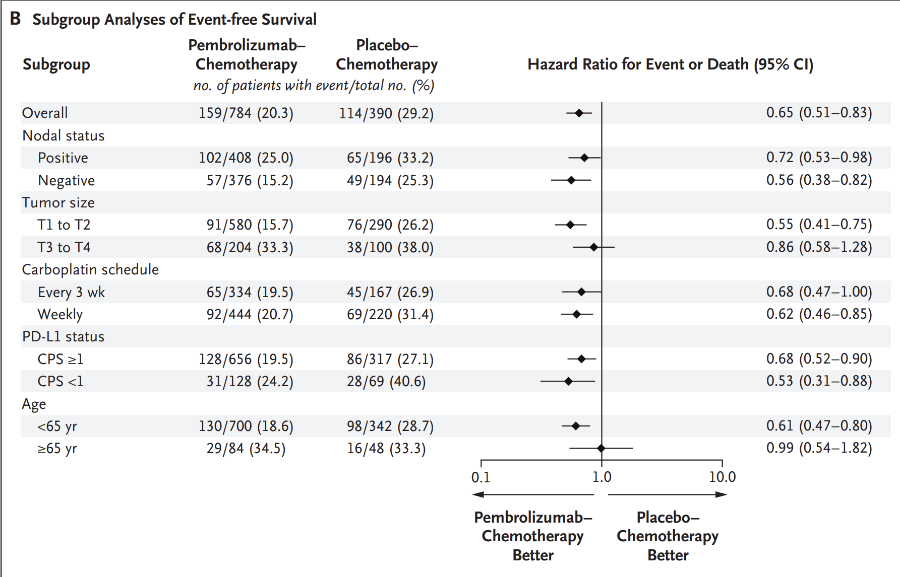
KEYNOTE-522 Covariate in Cox PH Regression

Slide 18
ACTIVE LEARNING

